Slide 1



















AWS Global Infrastructure
Region
Availability Zone
Edge Location

Slide 2




































Slide 3


























Slide 4
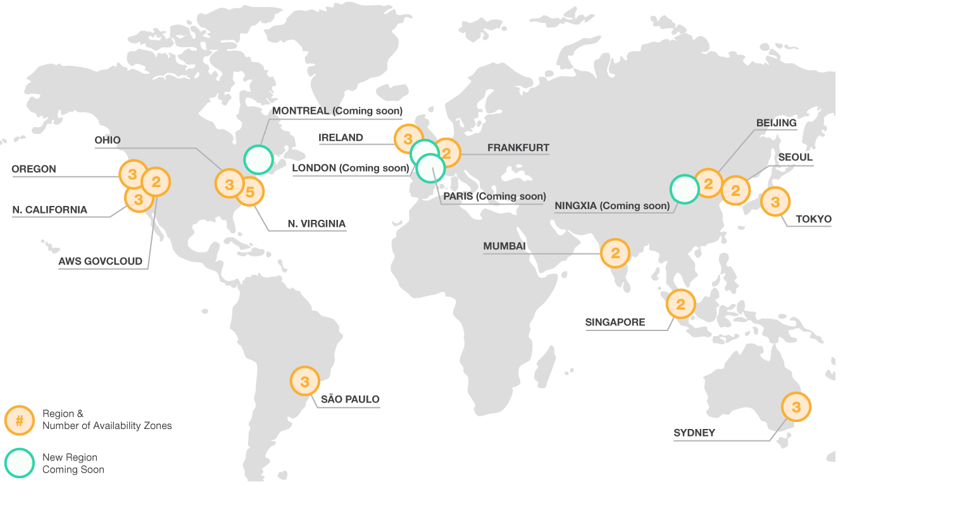
24 Regions + 3 Announced Region 76 Availability Zones 205 Edge Location 11 Regional Cache 212 + Services

Slide 5

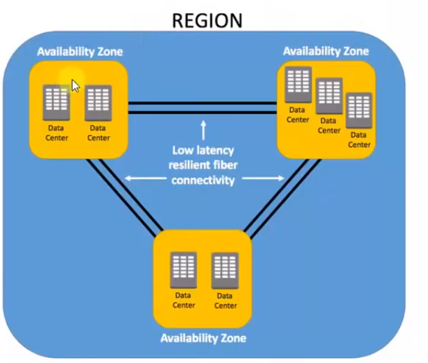
Region = Independent Geographic area Availability Zone = Multiple isolated location / datacentre within a region
Except Beijing all regions have at least 3 availability zones

Slide 6
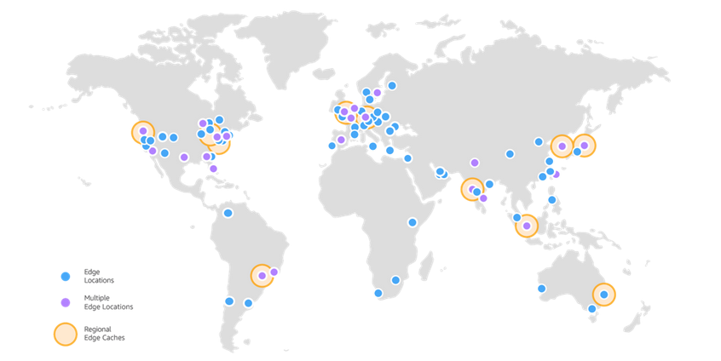
Edge location

Slide 7













































Slide 8















Slide 9
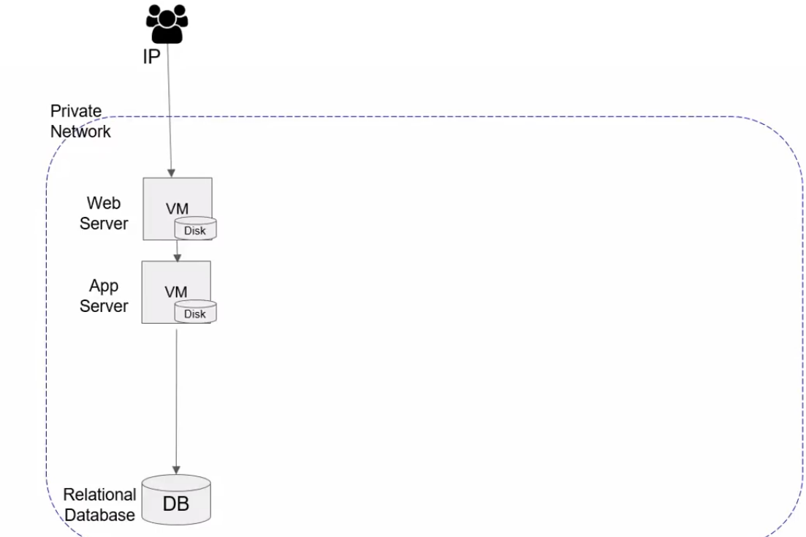















Slide 10
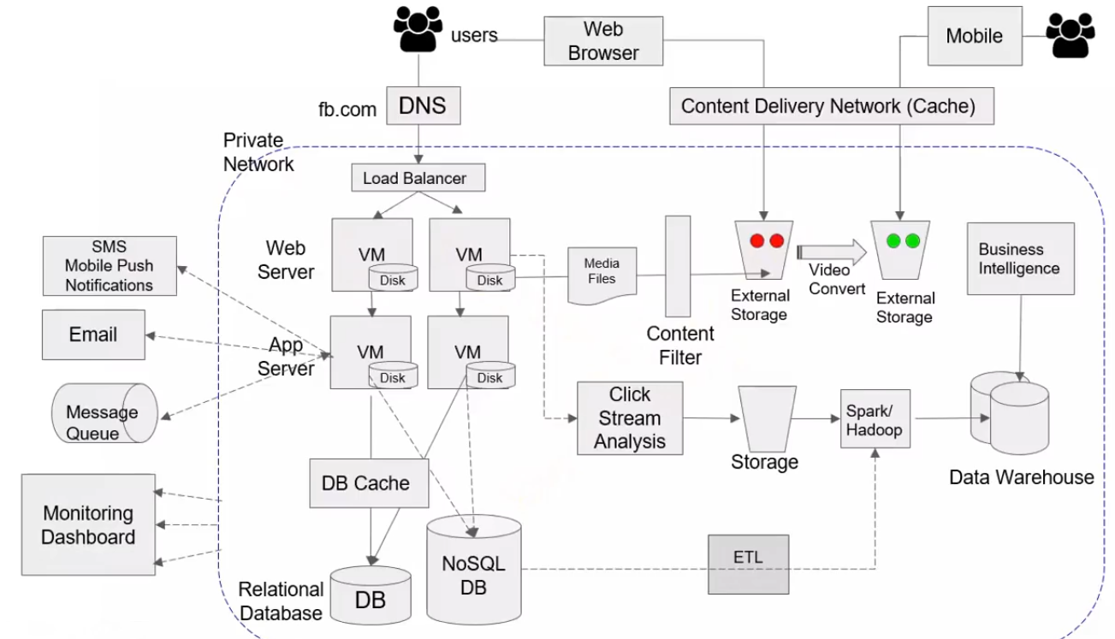






Slide 11



































Slide 12
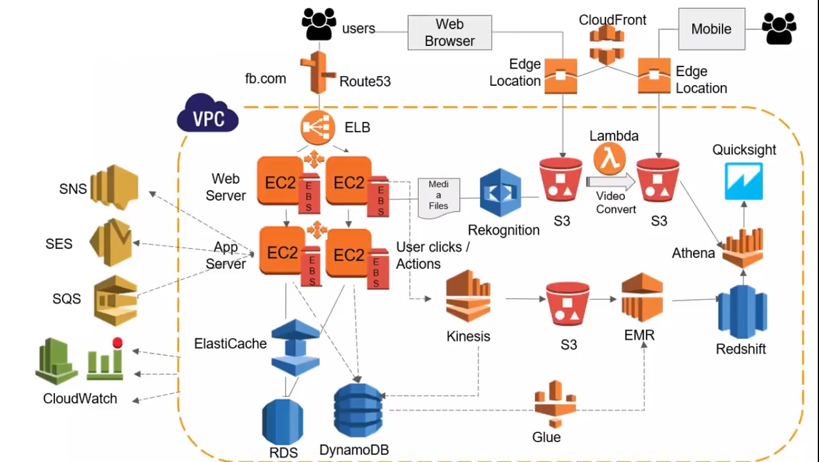



Slide 13
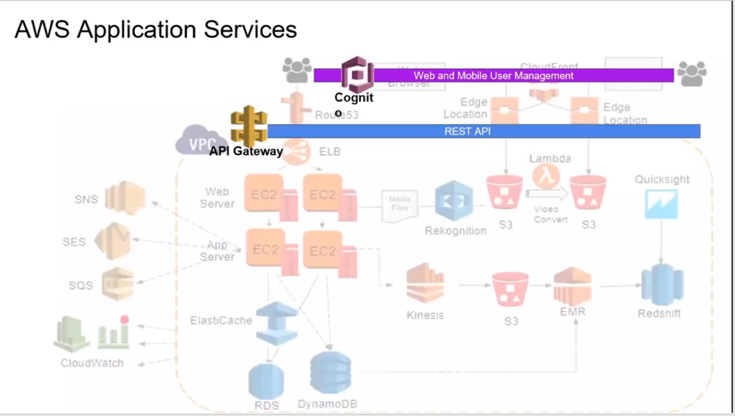


Slide 14
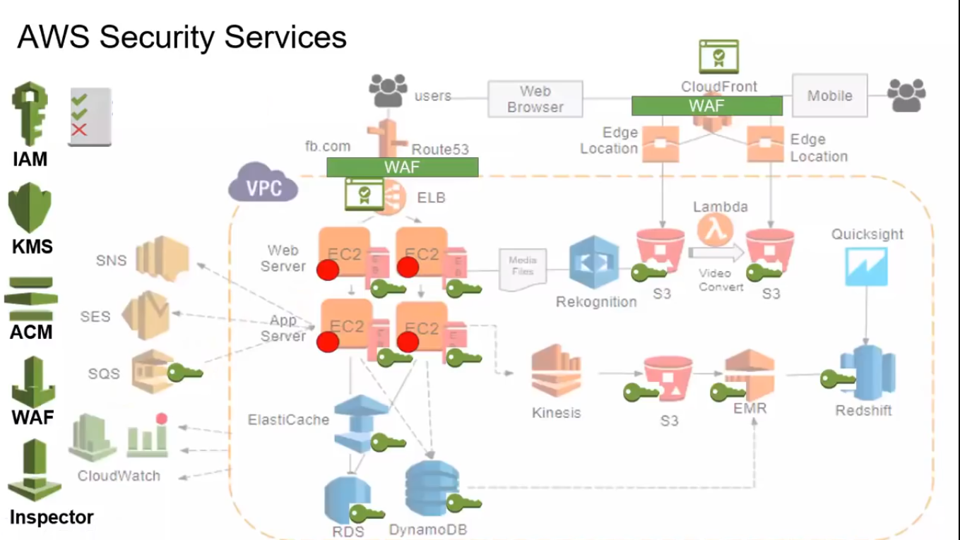

Slide 15
